Slide 1

CAPSTONE PROJECT | 2026
OcuSmart
Team Members
Ridhi Sood (102305055)
Prachita Garg (102305075)
Yuvraj Singh (102305087)
Aryaman Padap (102305051)
AI-Powered Portable Autorefractor
BE Third Year – Electronics Instrumentation & Control
Bridging Clinical Accuracy & Everyday Accessibility
Mentors: Dr. Gagandeep Kaur & Dr. Swati Sondhi
Thapar Institute of Engineering and Technology, Patiala

Slide 2
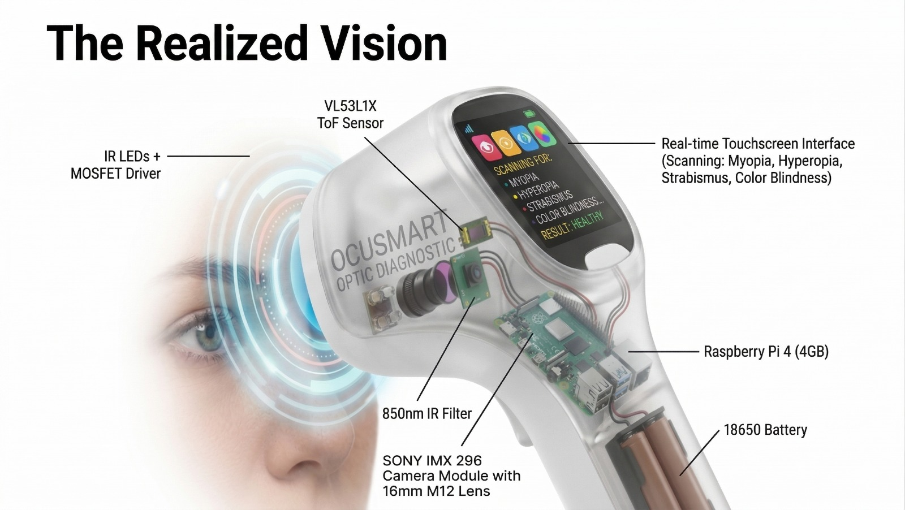
Introduction
An affordable, portable AI-based autorefractor designed for objective eye screening in rural and low-resource areas. The system combines infrared illumination, optical sensing hardware, and AI-driven software to estimate refractive errors including myopia, hyperopia, astigmatism, and color blindness.
Key Innovation: Eliminates need for uncomfortable mydriatic eye drops while providing accurate refractive measurements in seconds.

Slide 3
Need Analysis
Global Vision Crisis
Clinical Bottleneck
Refractive errors are the most common and easily correctable causes of vision impairment worldwide.
Traditional screenings require expensive, heavy equipment and trained professionals to operate.
Time-Consuming
Accessibility Gap
Standard procedures need mydriatic eye drops, causing discomfort and blurry vision for hours.
Limited access to optometric care in rural and developing regions leaves conditions undiagnosed.

Slide 4
Objectives
01
02
Design Prototype
Real-Time Algorithms
Handheld, non-mydriatic photo-screening device for affordable mass vision screening.
Implement AI-driven detection of myopia, hyperopia, and astigmatism.
03
04
CVD Screening
Retinal Health
Develop color vision deficiency testing via pupil constriction response measurement.
Establish method for assessing overall retinal health using pupillary response.

Slide 5
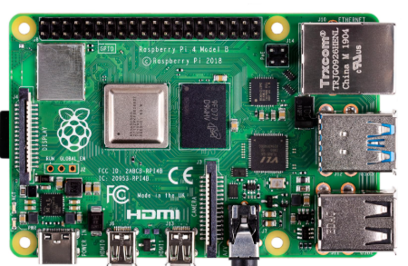
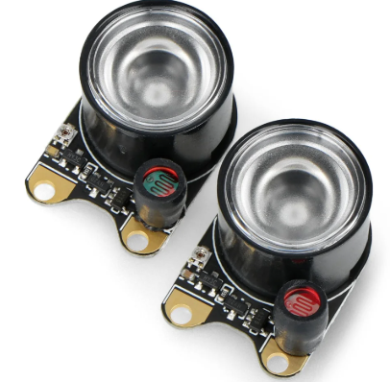
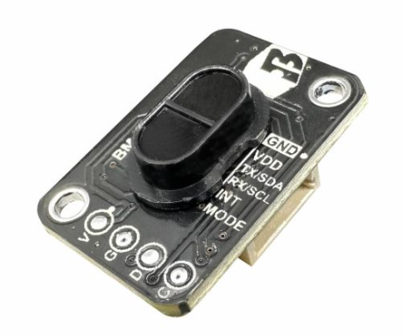
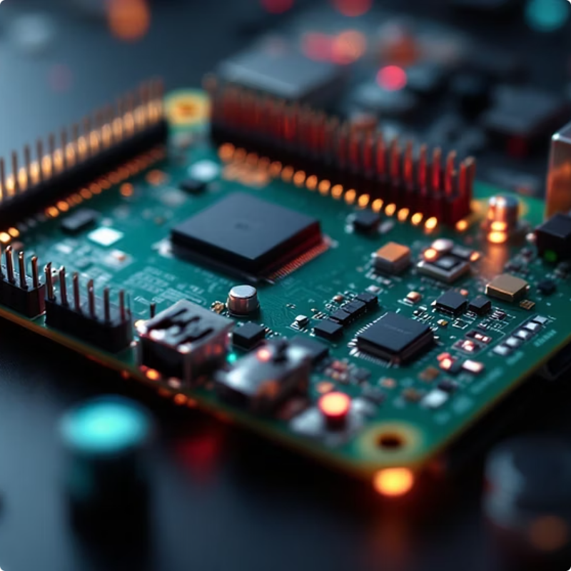

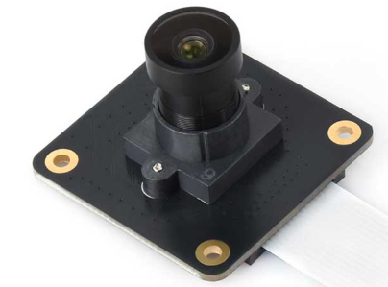


Hardware Components
Raspberry Pi 4 (4GB)
SONY IMX296 Camera
850nm IR LEDs
VL53L1X ToF Sensor
Central processing unit running Python/OpenCV vision suite and diagnostic engine.
Global shutter camera captures high-resolution retinal reflections without motion blur.
Safe infrared illumination captures "red reflex" without pupil constriction or discomfort.
Ensures correct focal distance between device and patient's eye for accurate readings.

Slide 6
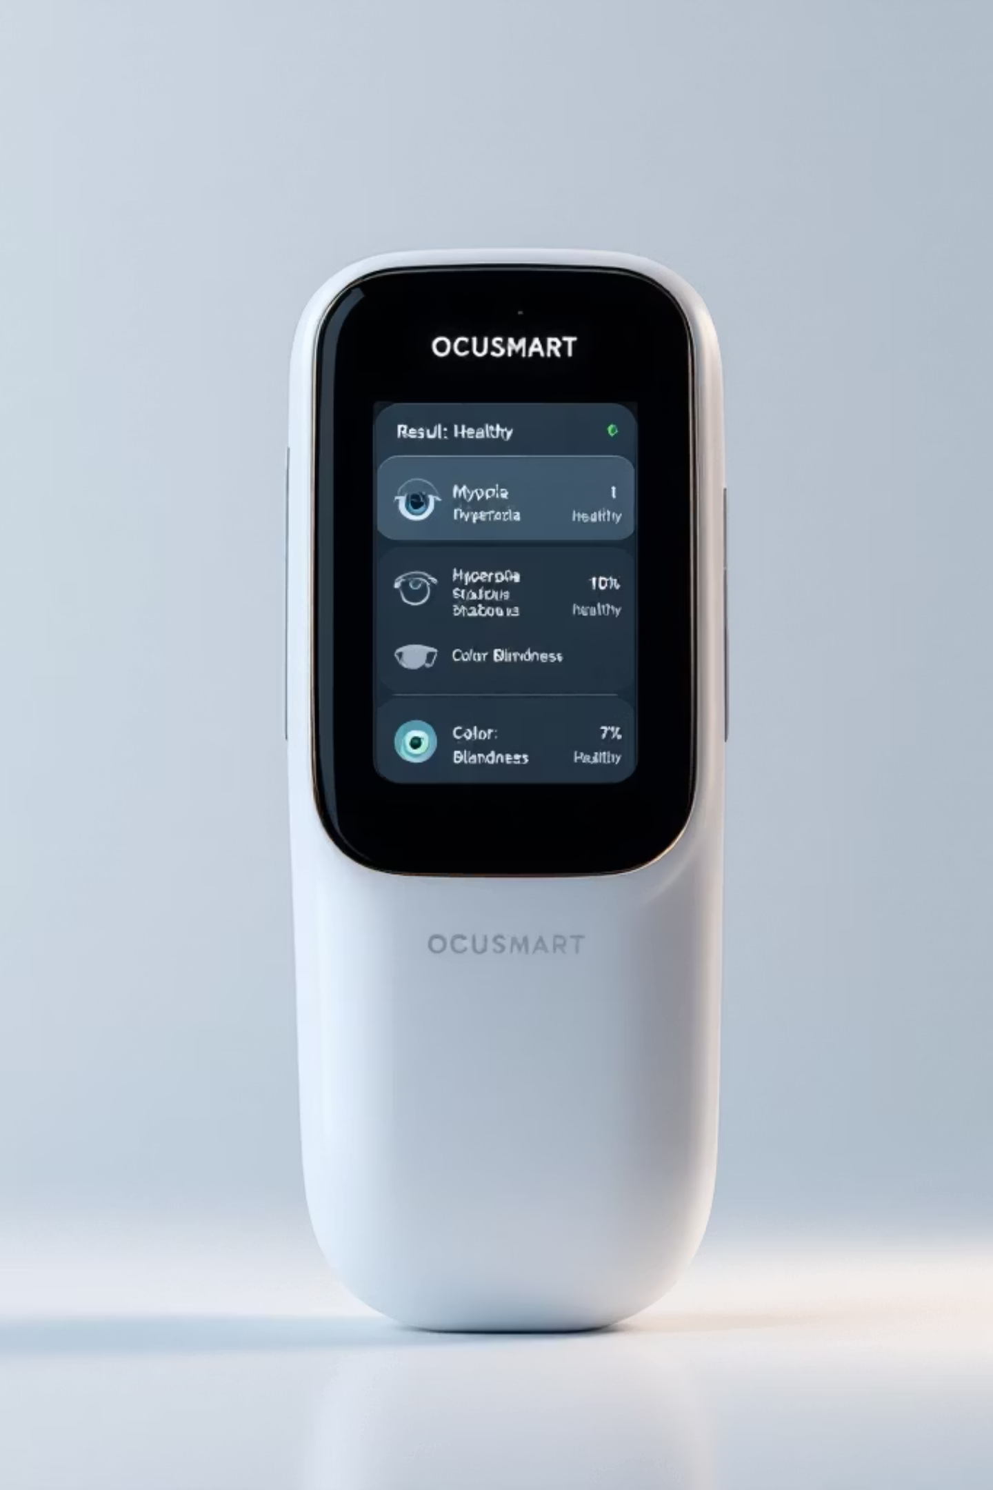

Software Architecture
Vision Suite
Python/OpenCV scripts for real-time pupil detection and red reflex geometric analysis using Hirschberg Ratio calculations.
Diagnostic Engine
AI algorithm classifies refractive errors and provides immediate "Pass/Refer" status on integrated touchscreen interface.
Chromatic Module
Software-controlled red/blue light pupillometry tests retinal sensitivity for color vision deficiency screening.

Slide 7
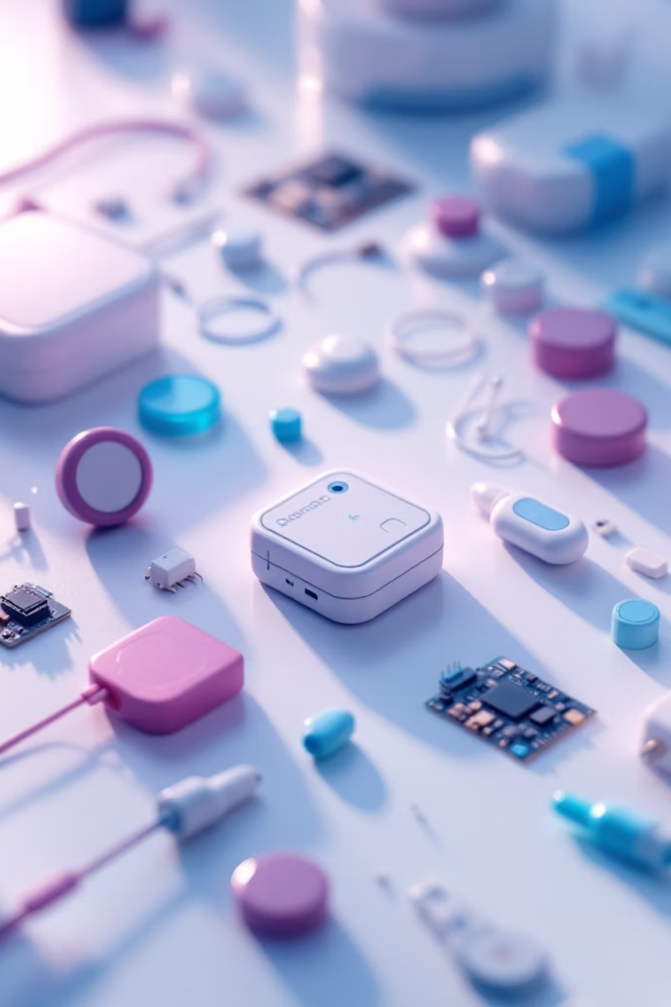
Cost Analysis
Component
Category
Cost (INR)
Raspberry Pi 4
Computing
8,000
Sony IMX296 Camera
Imaging
8,000
Custom 3D Printed Housing
Hardware
500
Touchscreen Display
Interface
4,500
LED/Lens Array
Optics
2,500
Total Prototype Cost
-
23,500

Slide 8
Design Specifications
25mm M12 Lens
850nm IR Filter
Custom-aligned optical assembly for high-resolution retinal reflection capture.
Blocks ambient light, isolates specific wavelength for clear "crescent moon" reflection analysis.
3.5-inch Touchscreen
Battery-Powered
Displays real-time automated diagnostic results with clear Pass/Refer status.
Untethered operation ensures portability for field environments and mass screening.

Slide 9
Key Design Goals
Portability
Non-Invasive
Handheld, battery-operated unit for field use in clinics and rural environments.
No uncomfortable eye drops required—uses safe infrared illumination instead.
Speed
Accuracy
Results in seconds rather than minutes, enabling mass screening efficiency.
AI-driven computer vision provides reliable refractive error classification.
Cost-Effective
User-Friendly
Total build cost under ₹25,000 ensures widespread accessibility.
Simple interface accessible to non-expert operators in resource-limited areas.

Slide 10
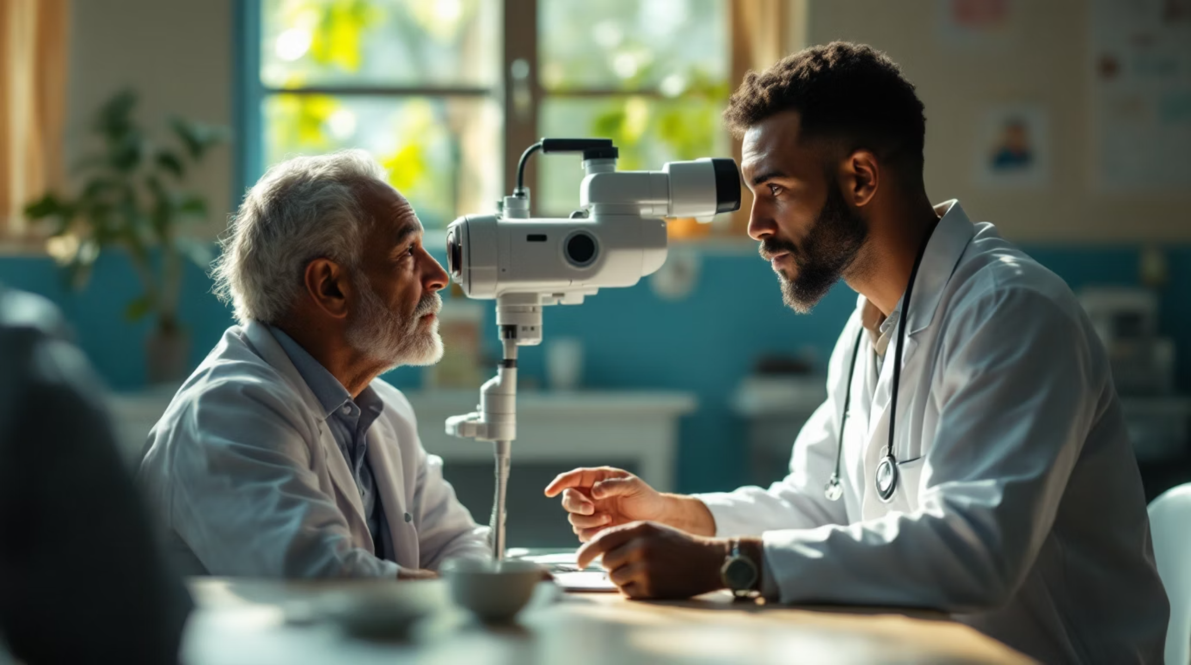
Impact & Future Vision
Revolutionizing Eye Care
OcuSmart bridges the gap between clinical accuracy and everyday accessibility, offering a solution that could transform teleophthalmology and promote equitable eye care worldwide.
Target Populations
Infants and non-verbal individuals
Rural and underserved communities
Mass screening programs
Resource-limited healthcare settings

